Slide 1
Automated patient insurance system
apis

Slide 2
about
It's a fact of life: people checking into the hospital face risks. Expecting to get better,
some actually wind up getting worse.
So, basically what our work is to ease this process we only need the patient to state their condition
and their age through our automation we will do a thorough search on the internet for the best possible doctor available

Slide 3
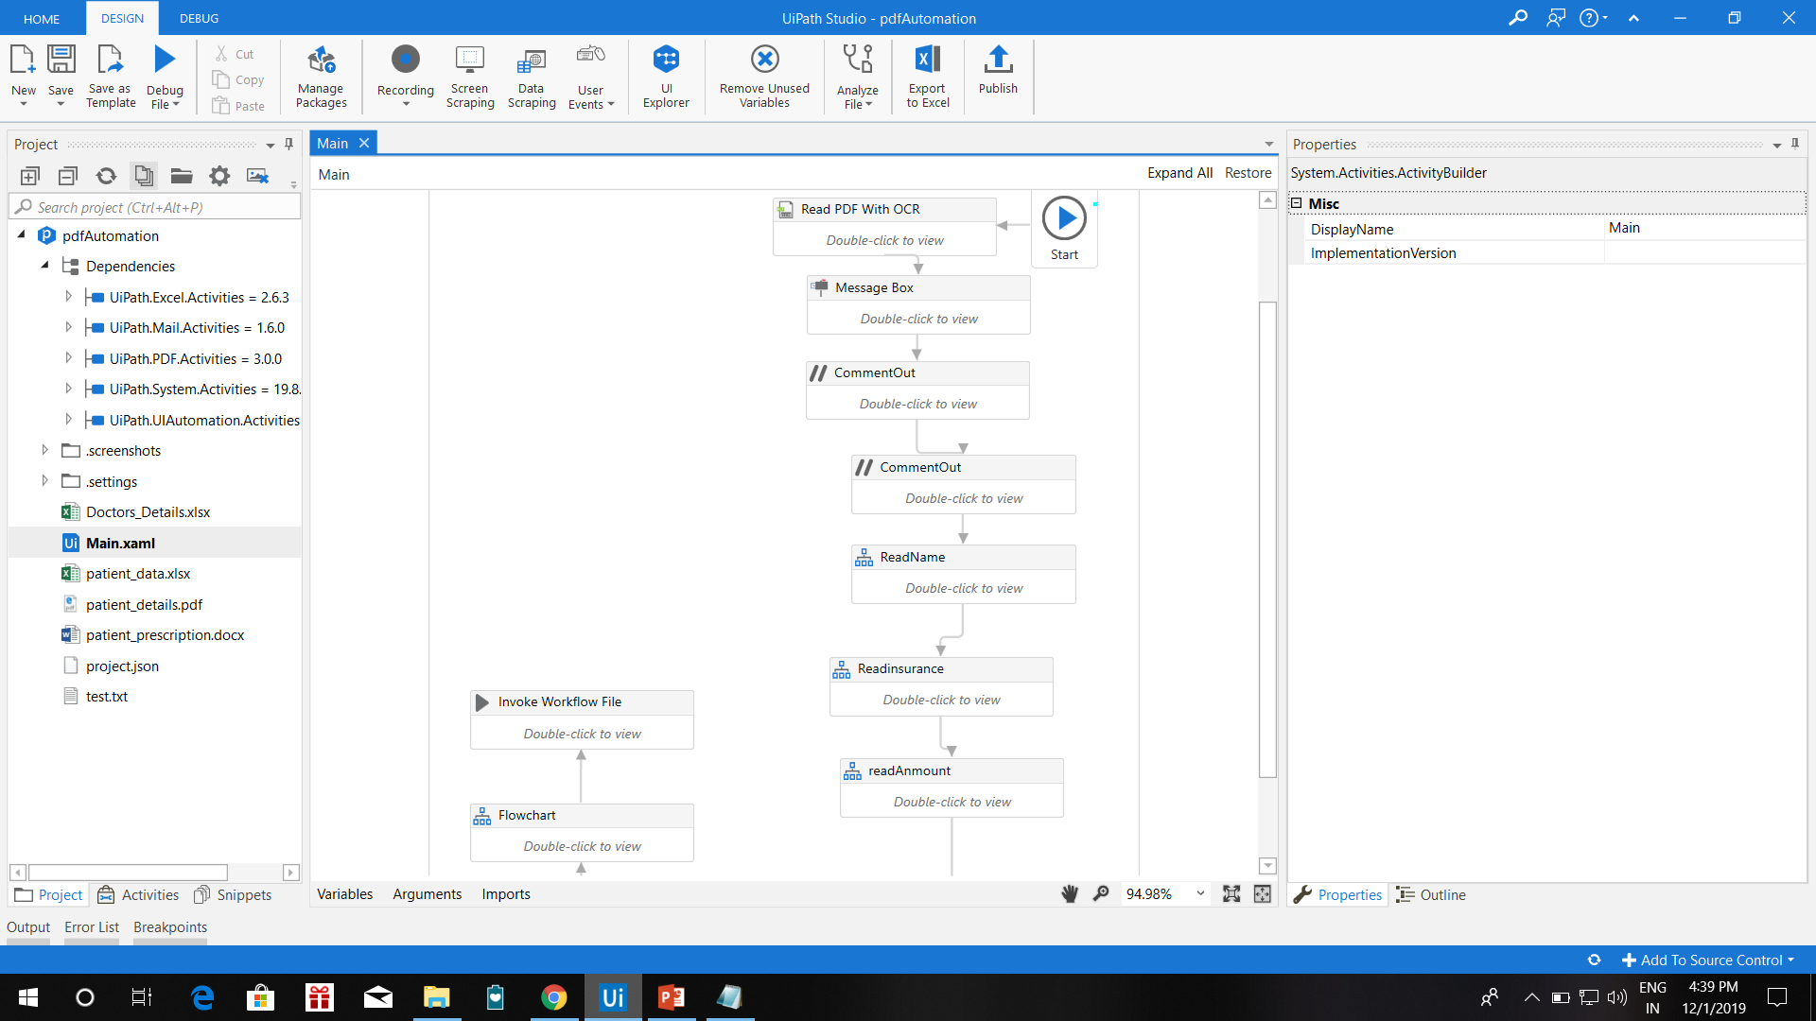
How it works
1. Here for automation we are using ui path.

Slide 4
Distribution of automation
2. here the automation is distributed into four parts:-
A. pdf automation
b. excel automation
c. e-mail automation
d. data automation

Slide 5
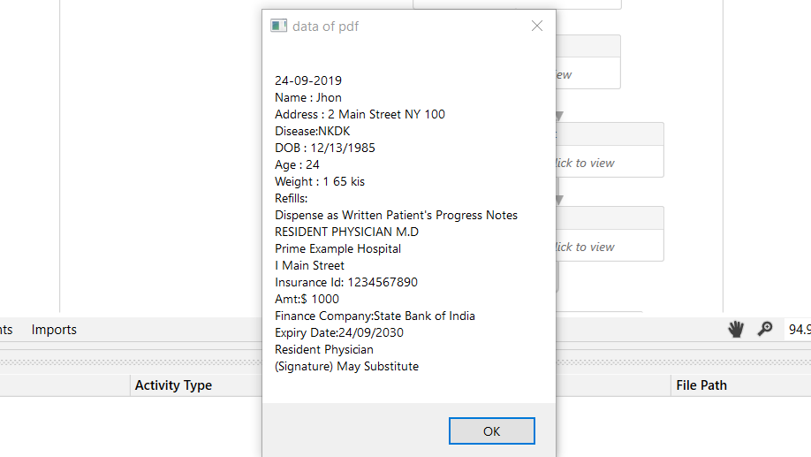
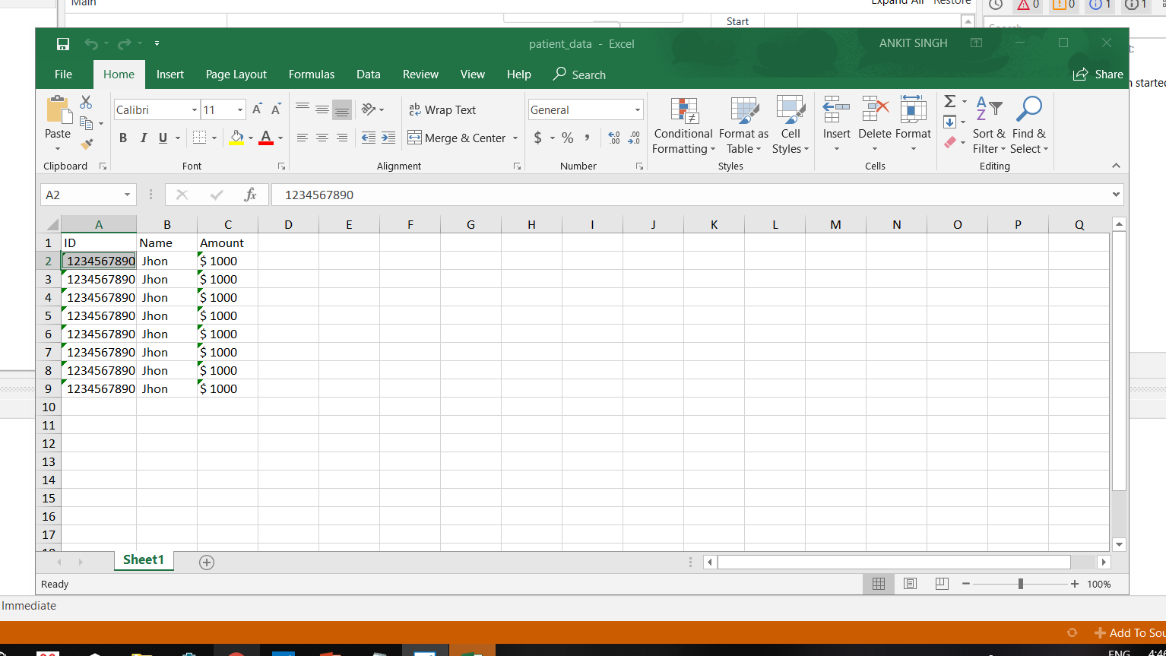
Pdf automation
Here we are reading data from pdf and saving it into our database.

Slide 6
Excel automation
here we are reading data from database and sending the data to insurance company about the verification of data

Slide 7
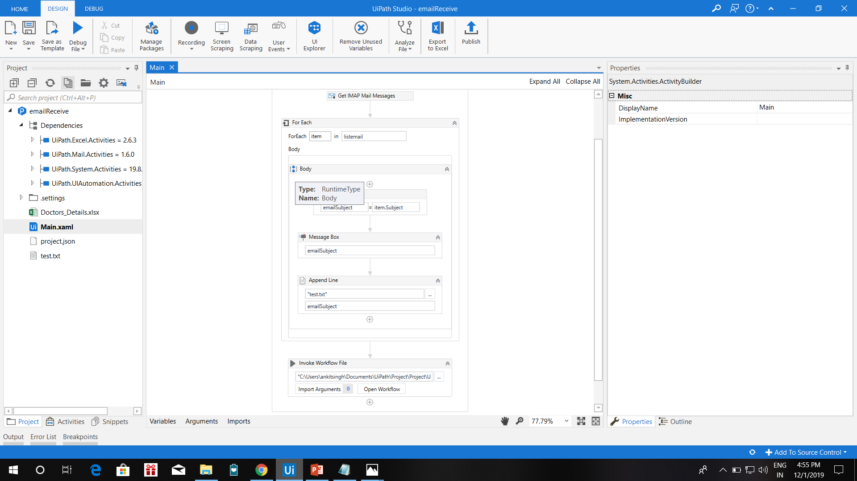
E-mail automation
After verification of insurance if needed, than we are sending the data of best doctor available according to the filters.

Slide 8
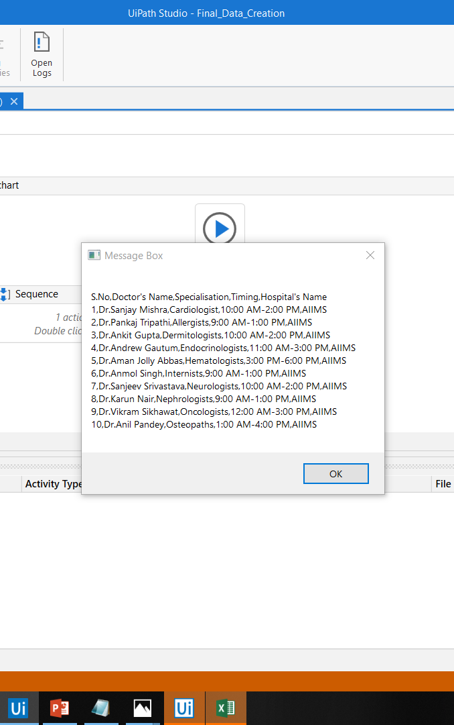
Data automation
Here the data is read and if appointment is to be done than it is done here

Slide 9
prototype
How will the user will interact using app

Slide 10
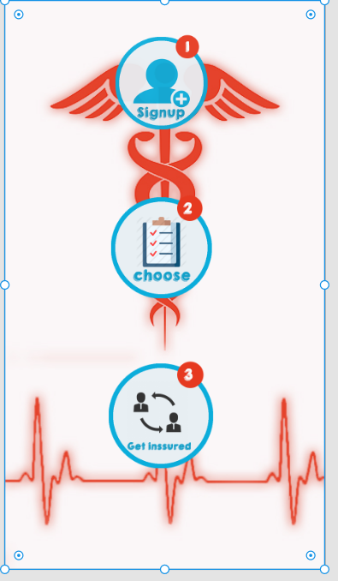

Slide 11
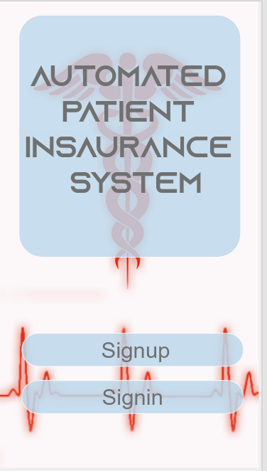

Slide 12
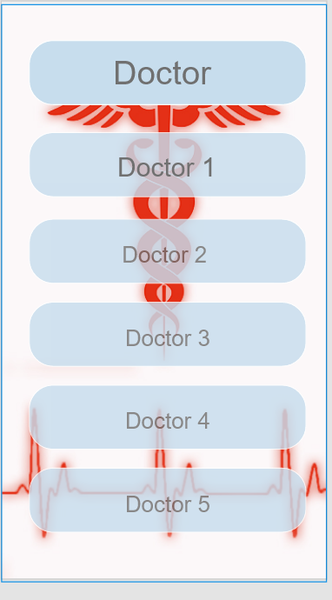

Slide 13
